Slide 1
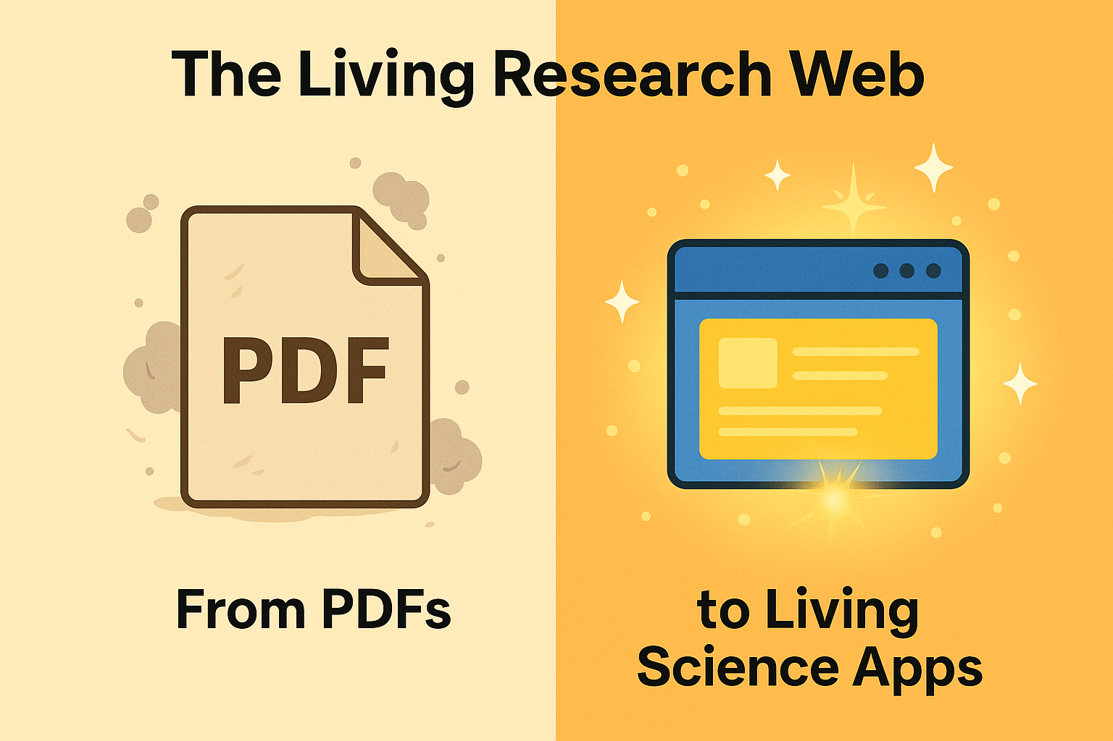
The Living Research Web
From PDFs to Living Science Apps

Slide 2
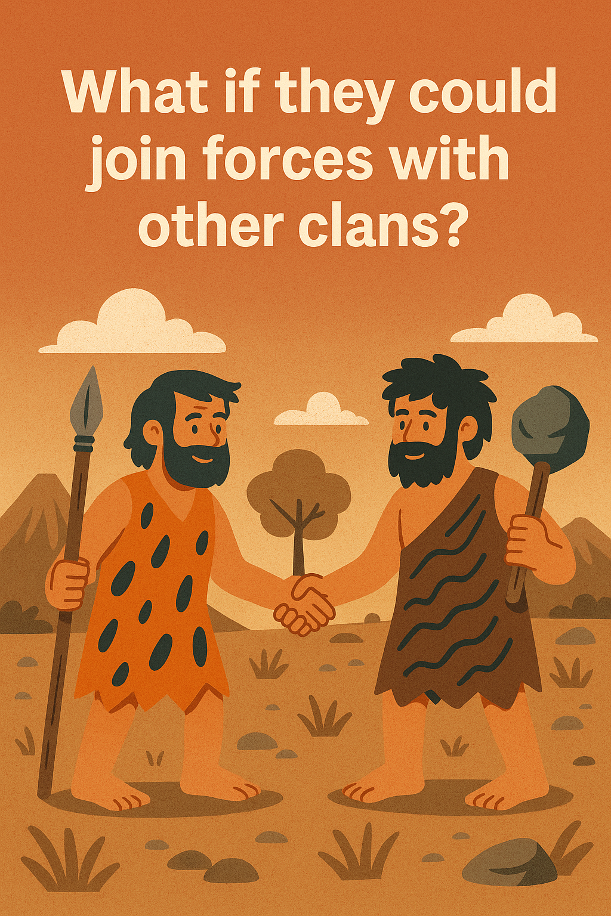
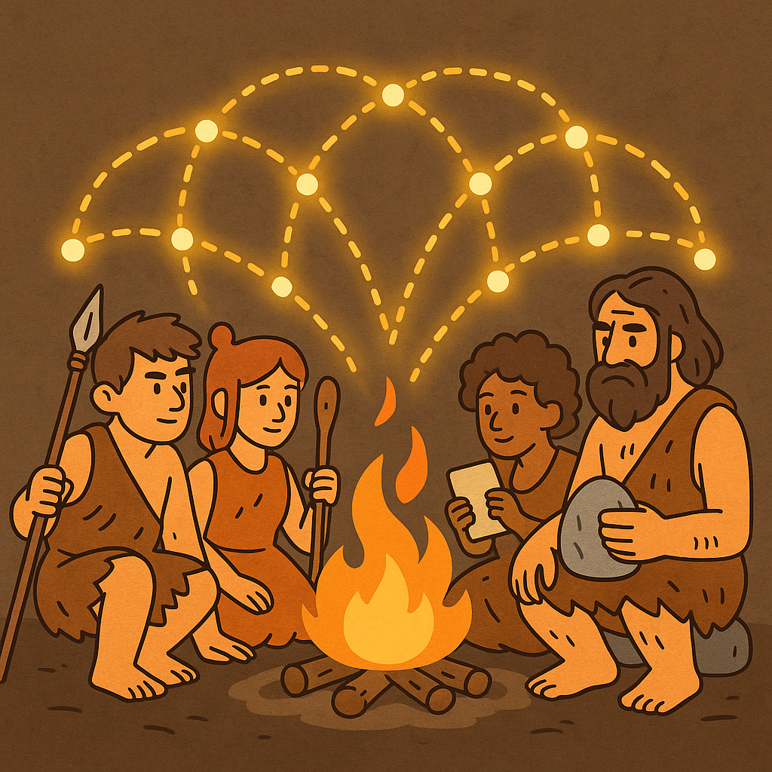
The Human Story
Humanity thrived by collaborating.
Clans shared fire, tools, and knowledge.

Slide 3
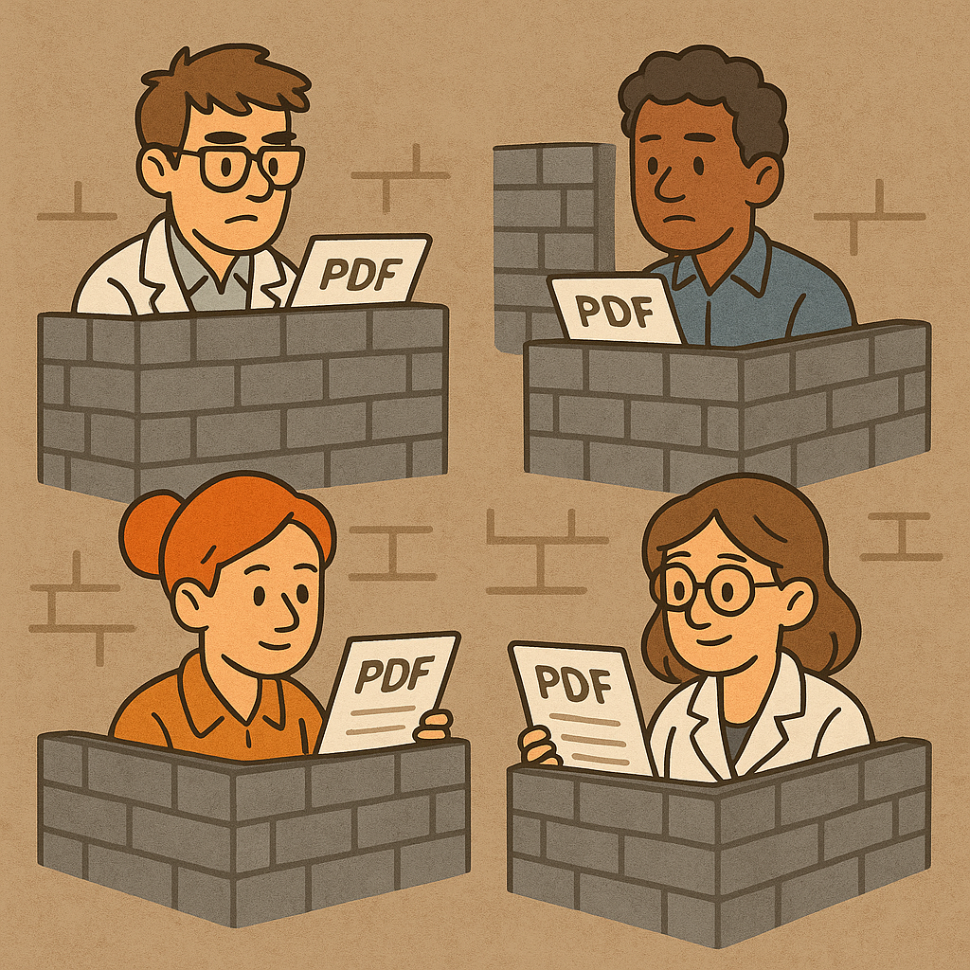
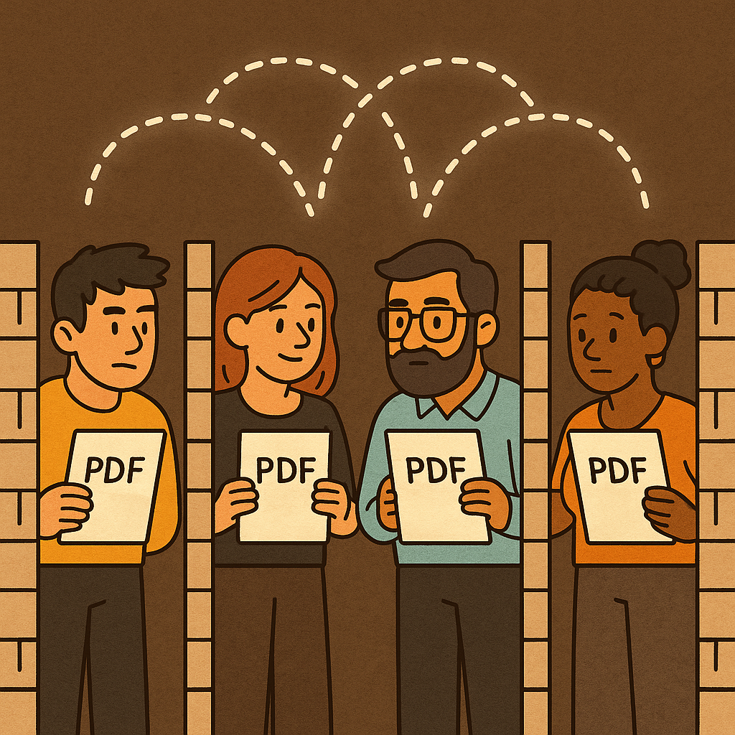
The Old Era of Science
Today, science is locked in PDF silos.
Researchers struggle to replicate and collaborate.

Slide 4
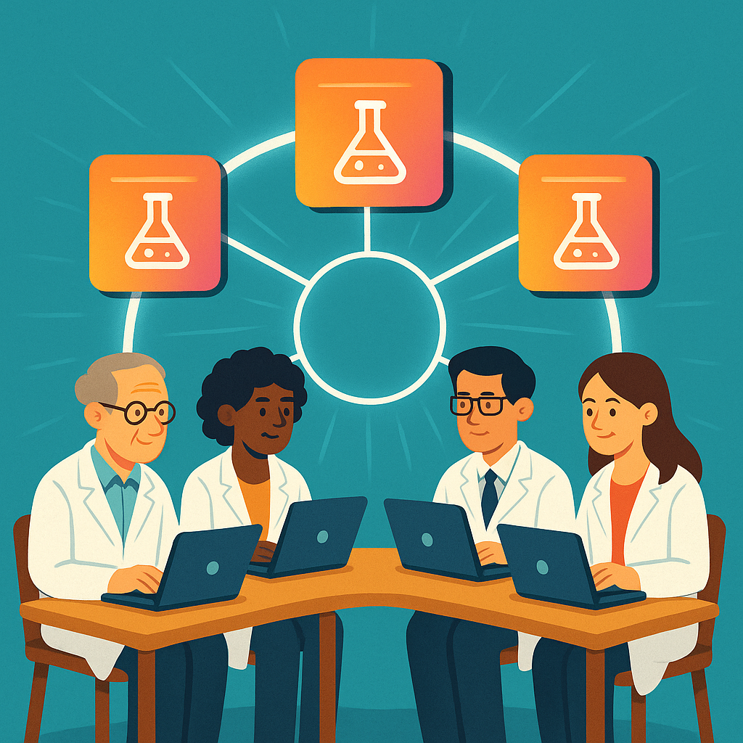
The New Era
Each project becomes a living app.
Workflow: Discover → Run → Build upon.

Slide 5
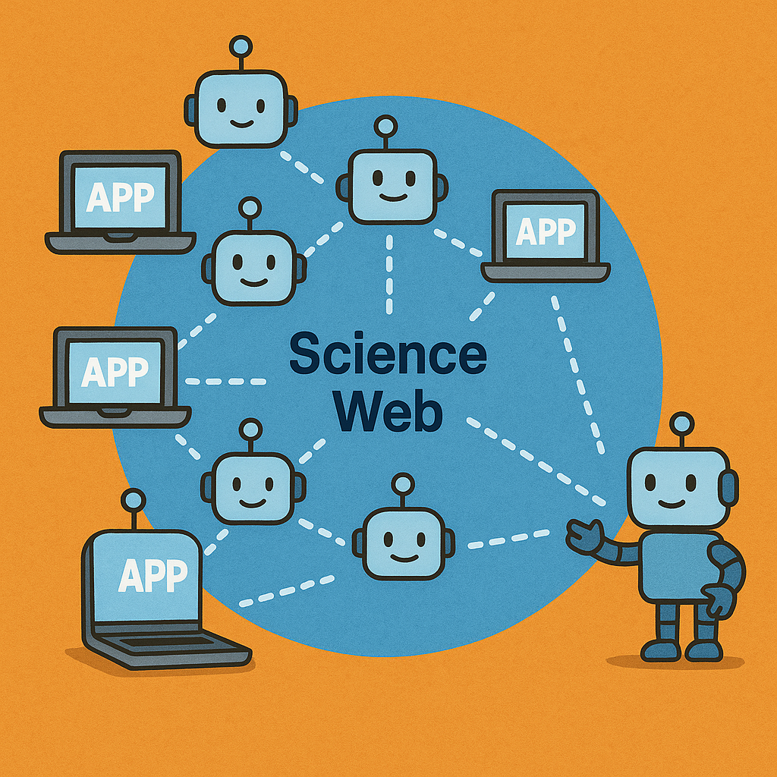
Agents as Collaborators
Every app has its own AI agent:
- Finds connections
- Requests permission
- Builds bridges

Slide 6
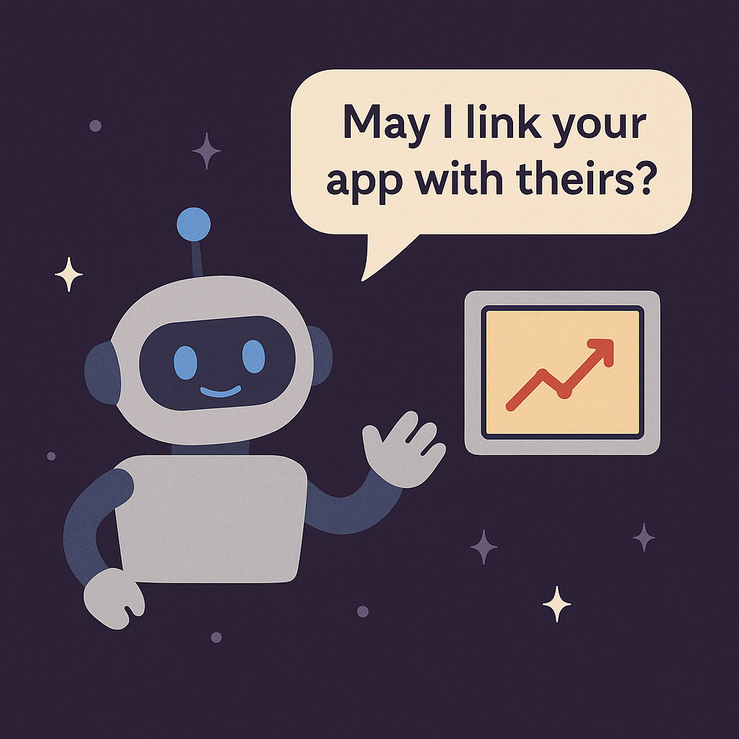
Permission & Control
Collaboration must be respectful.
Agents always ask:
“May I link your app with theirs?”

Slide 7
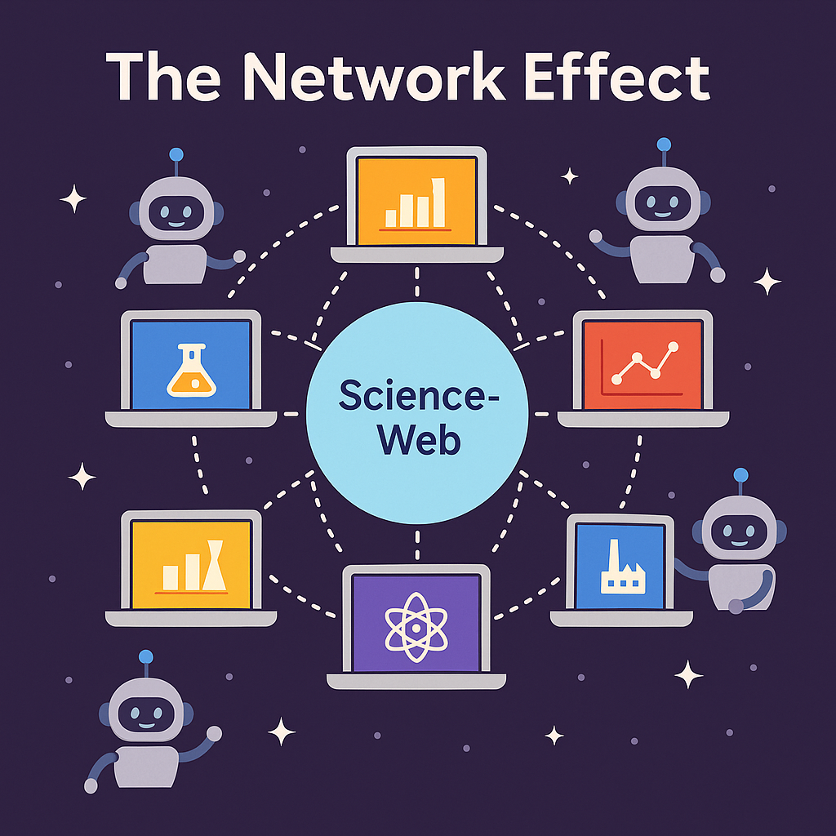
The Network Effect
More apps → Stronger network
Faster discoveries
Measurable impact

Slide 8
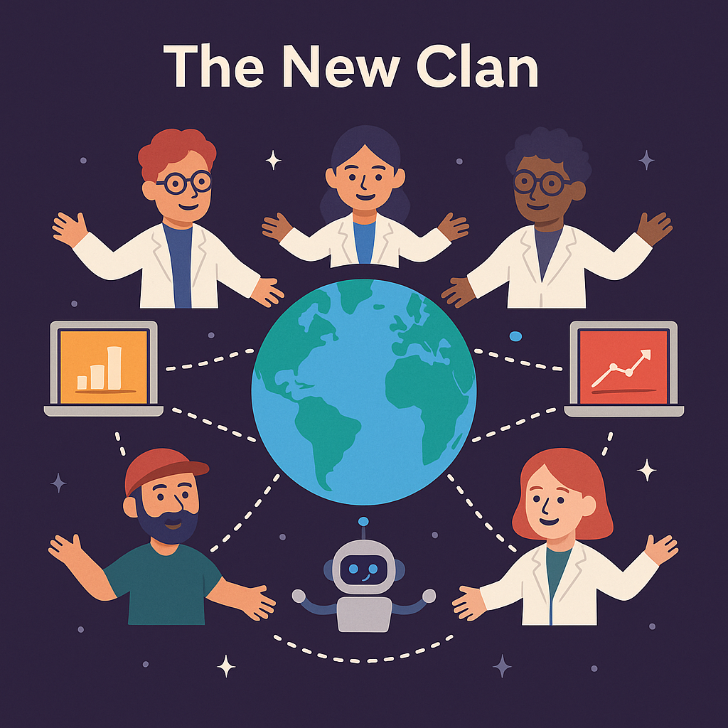
The New Clan
This is the new clan of humanity:
- Not bound by geography
- Not slowed by PDFs
- Science alive, connected, accelerated

Slide 9
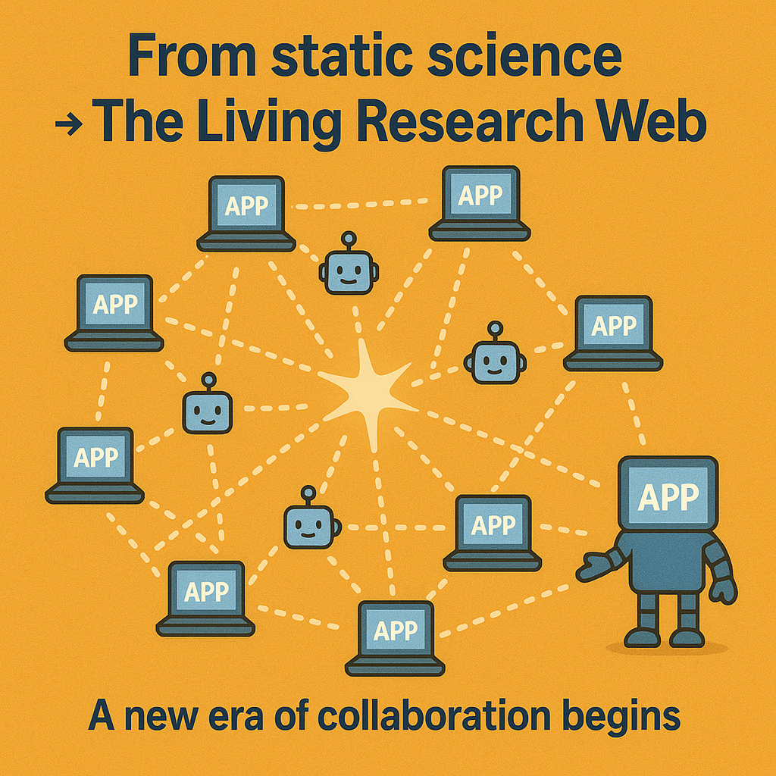
Closing
From static science → The Living Research Web
A new era of collaboration begins.

